Slide 1

Computer vision Project
PREPARED BY: MUHAMMAD AFIQ

Slide 2
Content
App1 : Shape detection
Intro
Result
App2 : Image and Video face recognition
Intro
Result
Code and Demo

Slide 3
App1 : Shape detection
Develop an app for :
- Detect any shape in an image
- Count the total number of objects
- Sort the objects by size

Slide 4
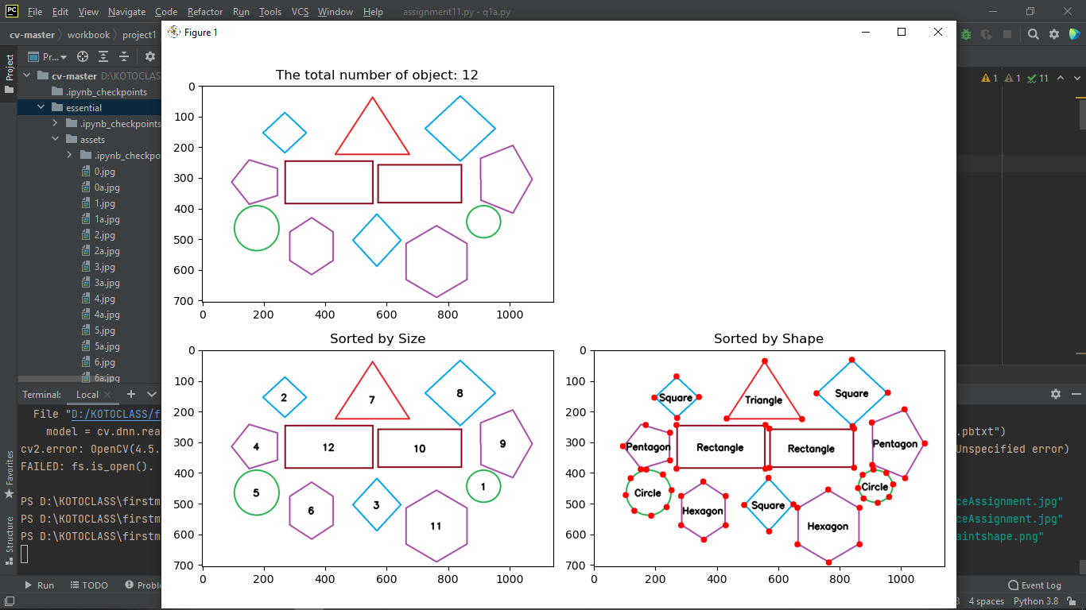
Result
Object detection
By size of shape or contours
By shape or contours

Slide 5
App1 : Shape detection
Develop an app for :
Sort the objects by size then shape
- Sort the objects by shape then size

Slide 6
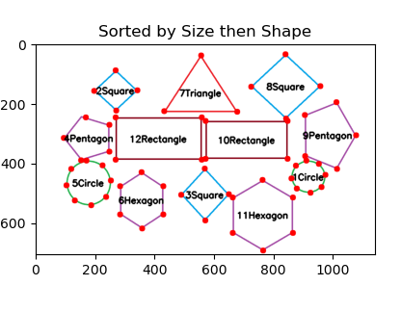
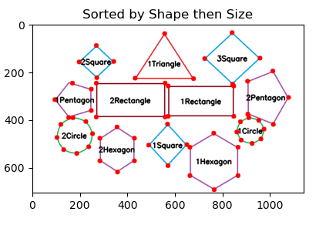
Result
Sorted by:
-Size of all shape
-Sort (small to large)
-Sort the shape by the name (number of angle)
Sorted by:
-Shape and size only on certain
Shape only.
-Sort (small to large)
-Sort the shape by the name (number of angle)

Slide 7
App1 : Shape detection
Develop an app for :
- Create another image of collection of similar shapes at original position

Slide 8
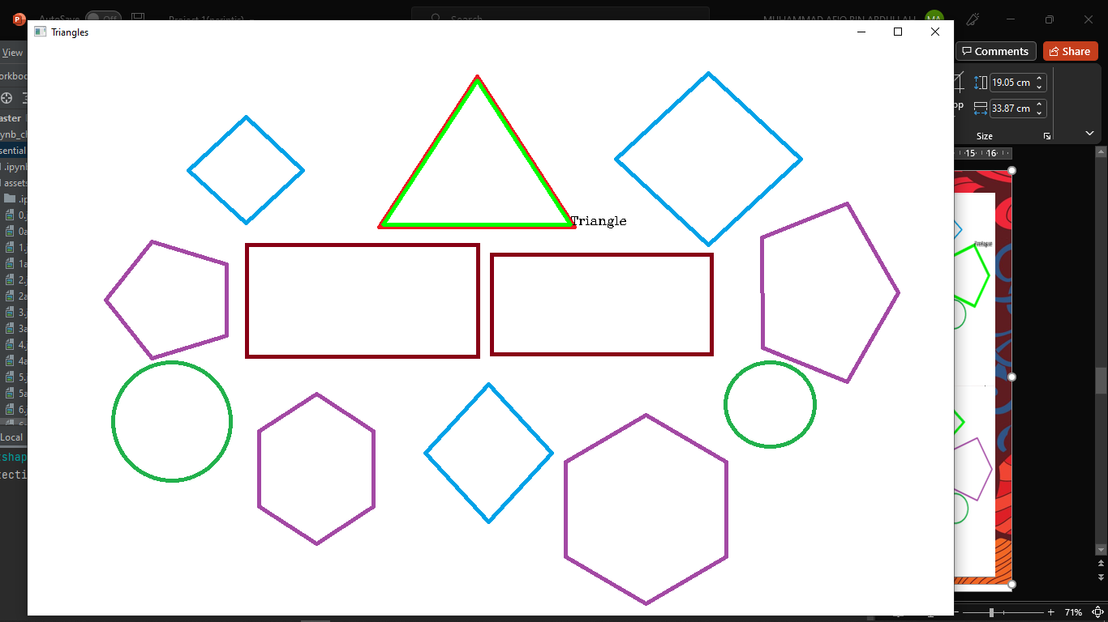
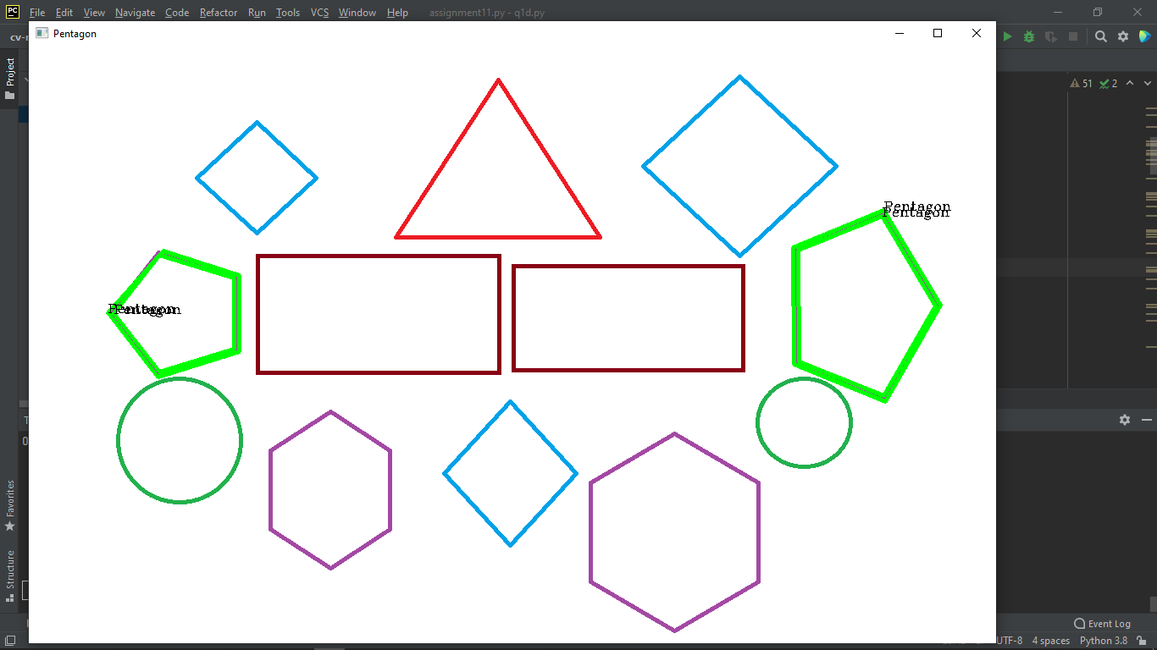
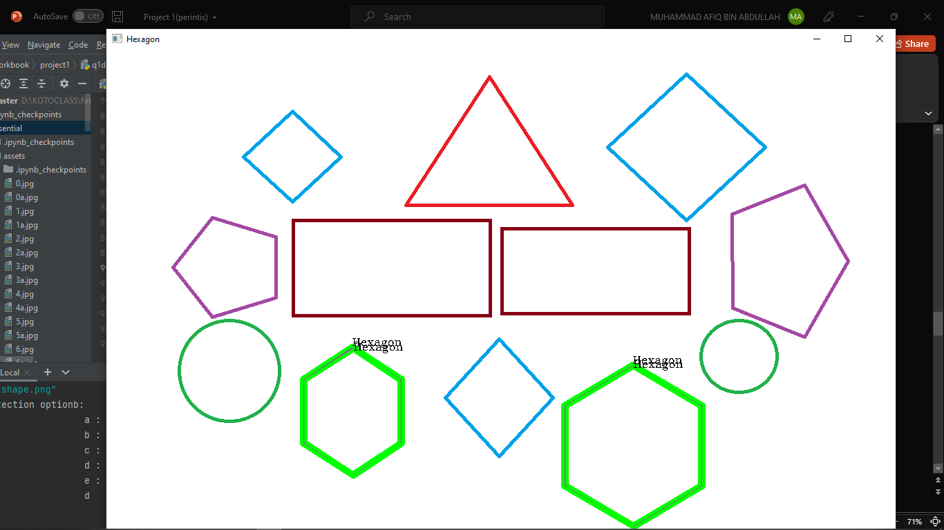
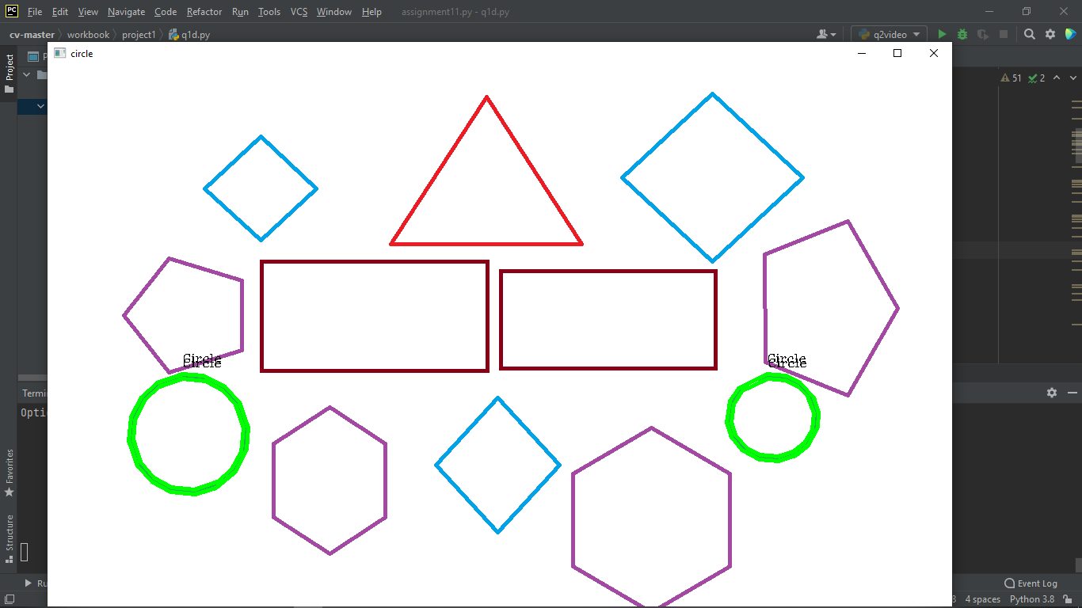
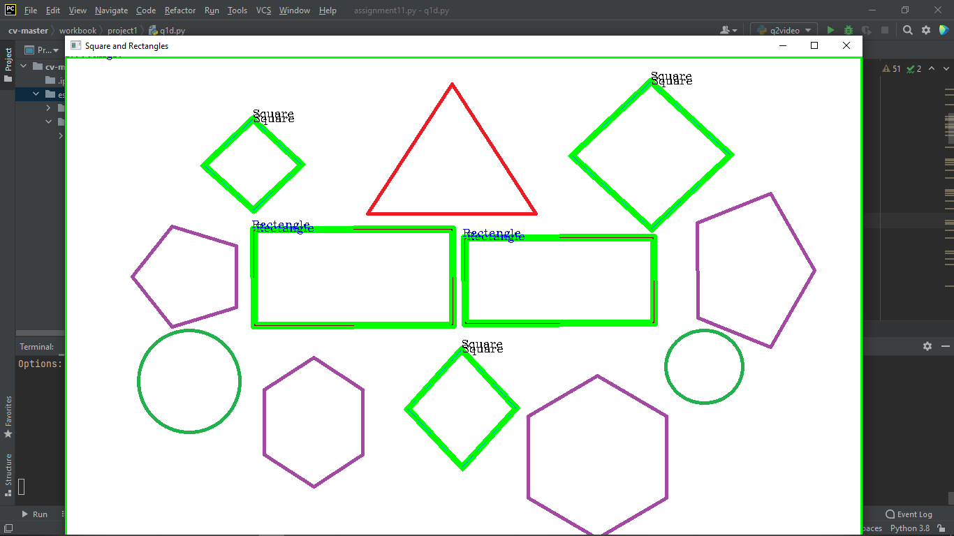
Result
Triangle
Pentagon
Shape detection by
user input:
Output- Shape in green border
Hexagon
Square & Rectangle
Circle

Slide 9
App2 : Image and Video face recognition
Develop an app for :
-Can recognize faces in an image

Slide 10
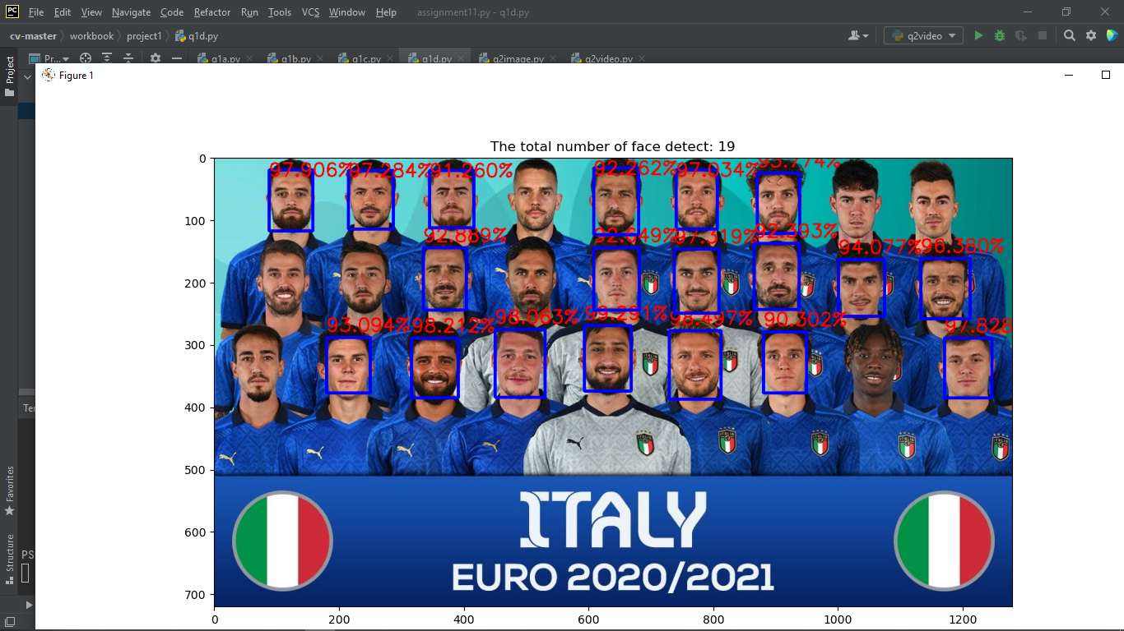
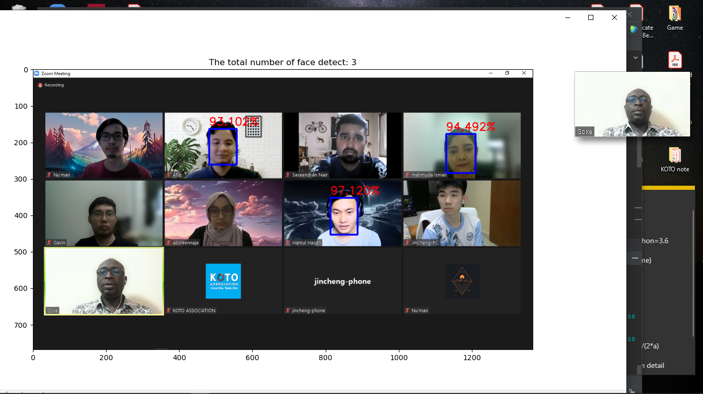
Result
Load model
opencv_face_detector_uint8.pb
opencv_face_detector.pbtxt
Output
Face detection in an image by 90% accuracy
l

Slide 11
App2 : Image and Video face recognition
Develop an app for :
-Can recognize faces in video capture

Slide 12
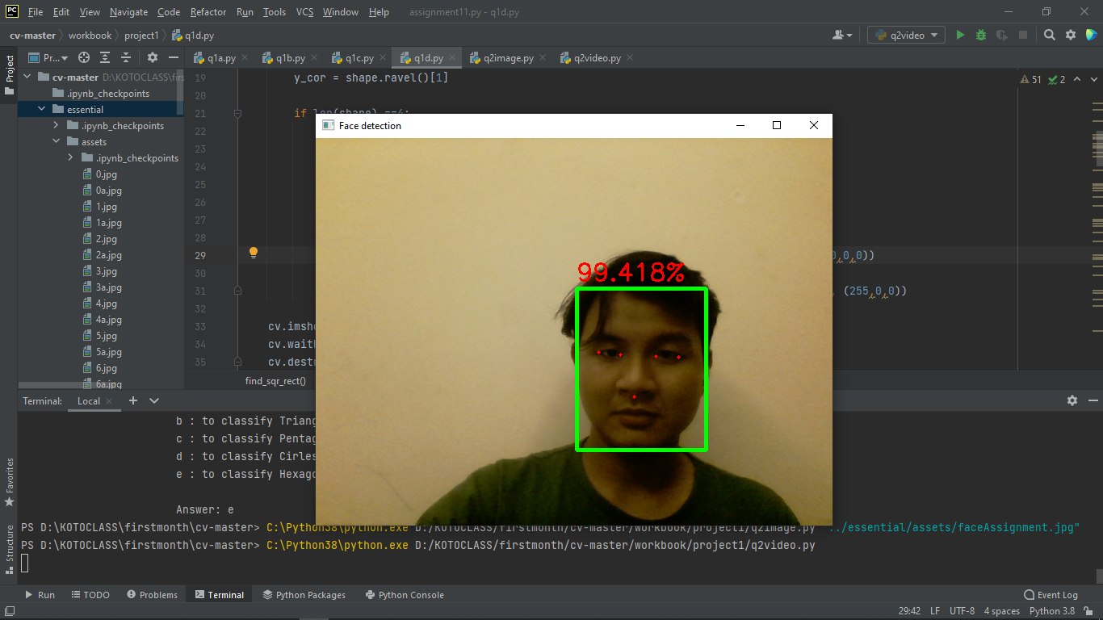
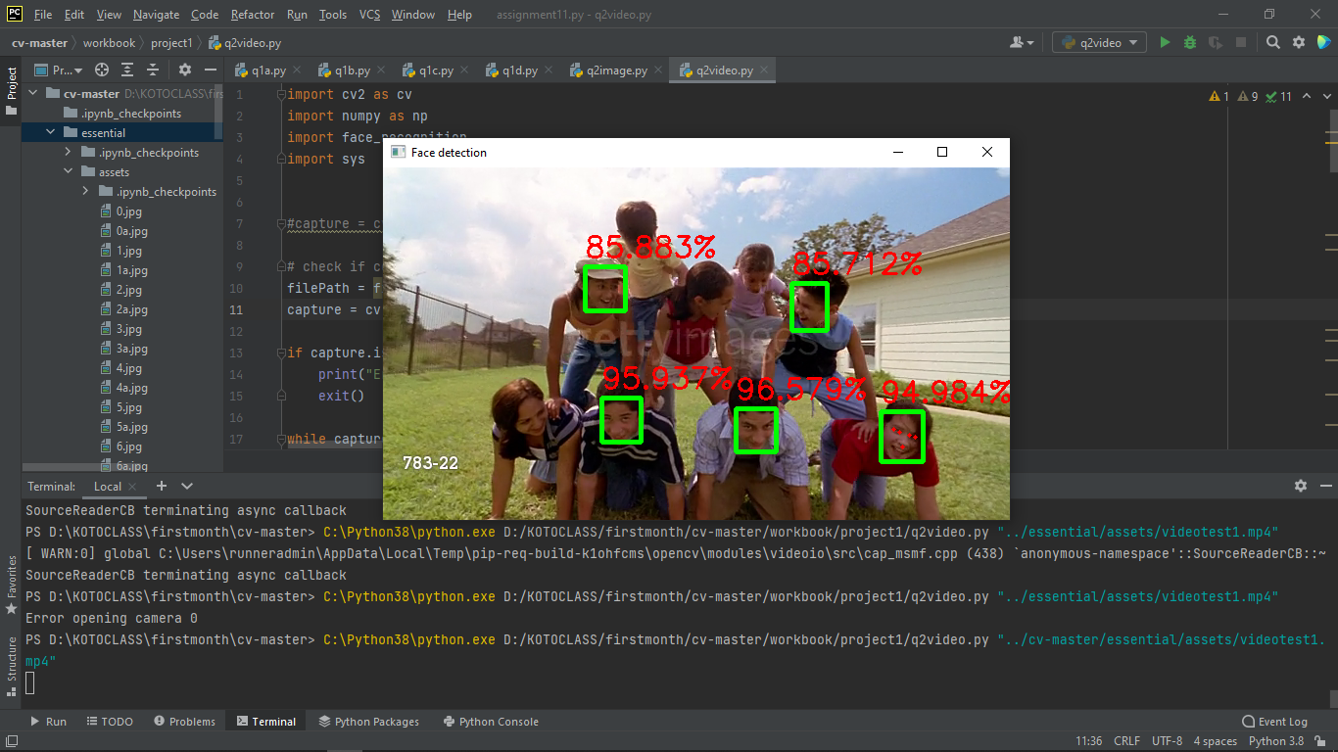
Result
Load model
opencv_face_detector.pbtxt
Output
Face detection in video by 90% accuracy
webcam
video file

Slide 13
Thank You

